Slide 1
CS131 Final Project STICKMAN ESCAPE
Tudor Iordan

Slide 2
Idea
Video game made with JavaFx
Stickman theme
2D Platformer style

Slide 3
Demo

Slide 4
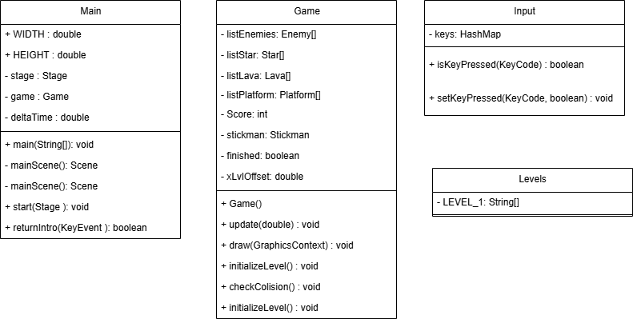
UML Diagram

Slide 5
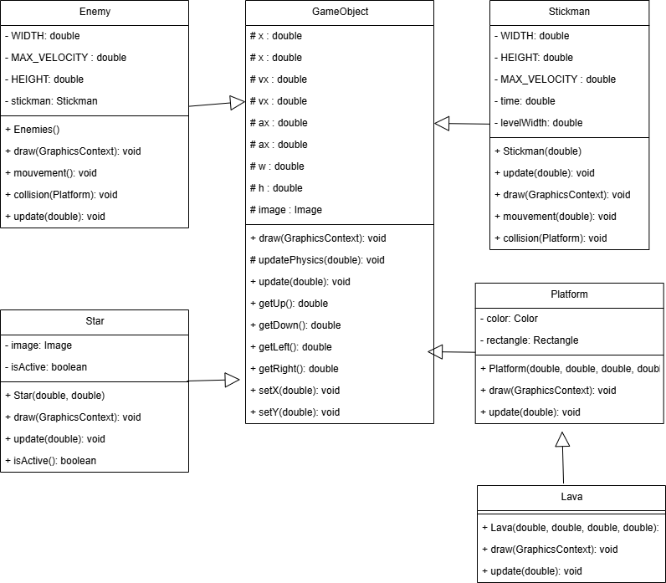
UML Diagram

Slide 6
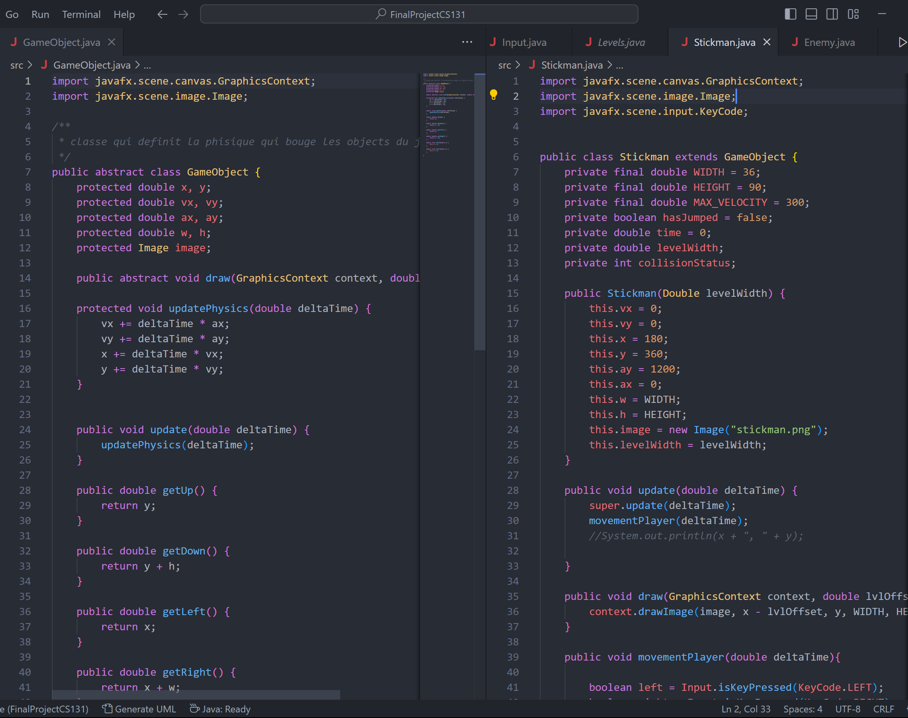
Inheritence
GameObject Class
Platform and Lava Class

Slide 7
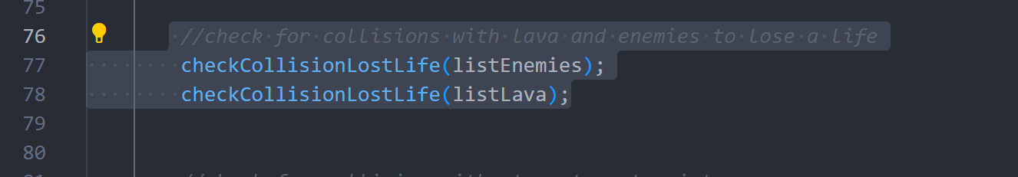
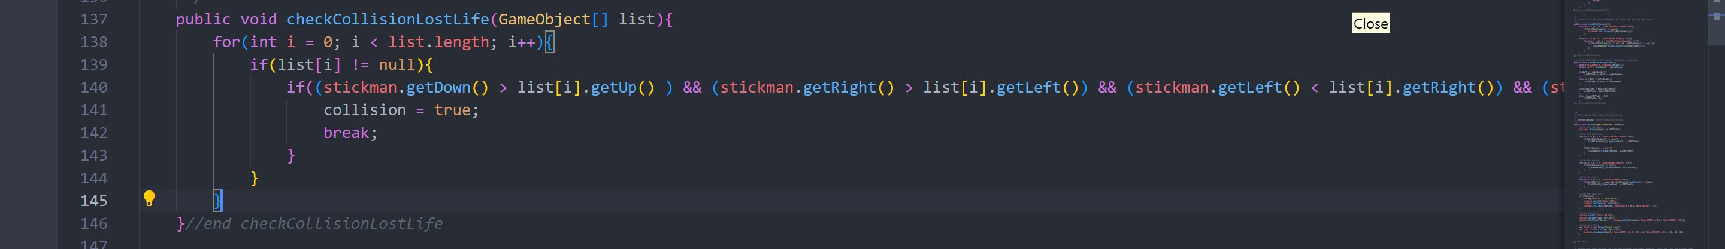
Polymorphism
GameObject Class
Collisions

Slide 8
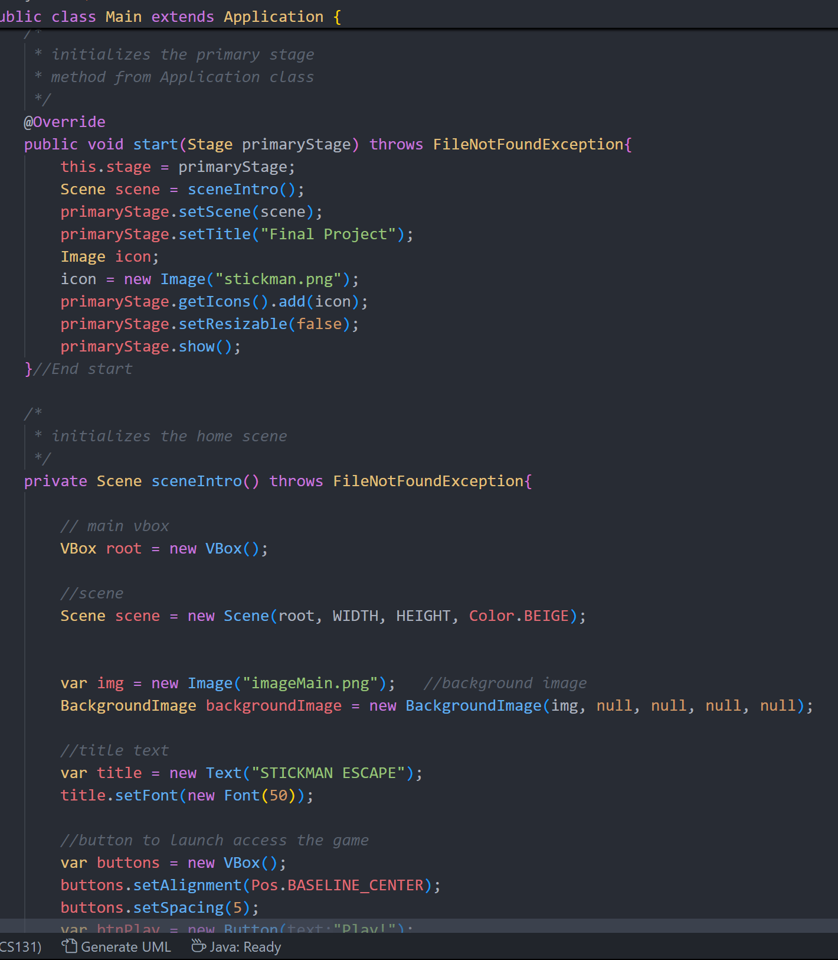
Exception Handling
FileNotFound for Images

Slide 9
Program Flaws and Improvements
More enemies and abilities
Better collisions
Music or sounds effects

